Slide 1
Excel Dashboard on Netmeds Data
In this project, I created an interactive Excel dashboard to analyze Netmeds pricing data for various pharmaceutical products. The dataset was cleaned and transformed using Text to Columns to categorize products into tablets, ointments, creams, lotions, and more.
The dashboard consists of four sheets, with the main focus on pricing analysis. Key features include:
Three slicers for filtering by Rx Required, Disease, and Country
Segmentation of product types for better analysis
Data visualization using Pivot Tables & Charts
Enhanced filtering and interactivity for better insights
This project demonstrates data cleaning, transformation, and visualization skills in Excel, making it useful for pharmaceutical pricing analysis. 🚀

Slide 2
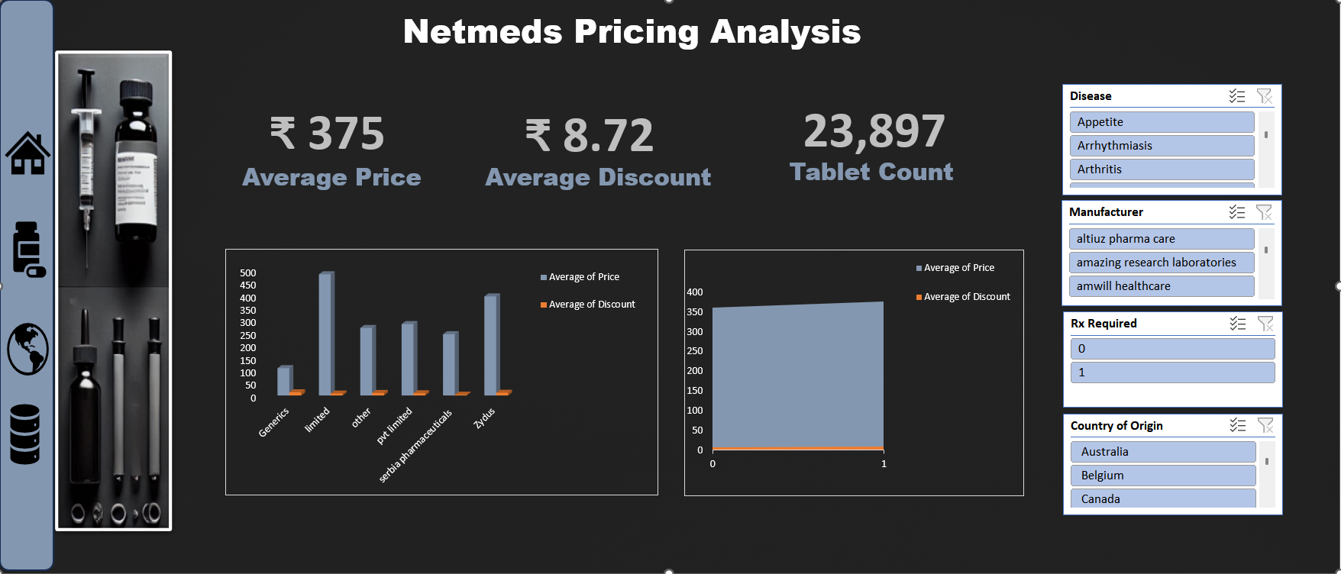

Slide 3
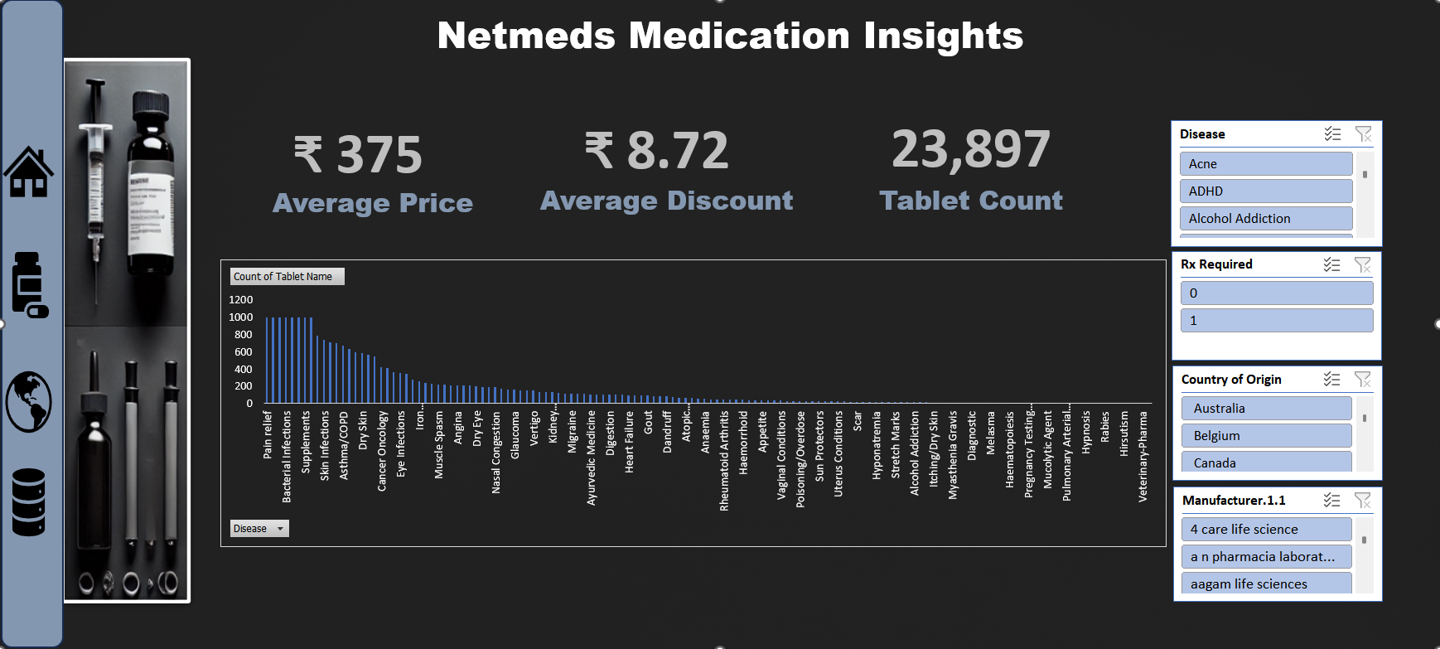

Slide 4
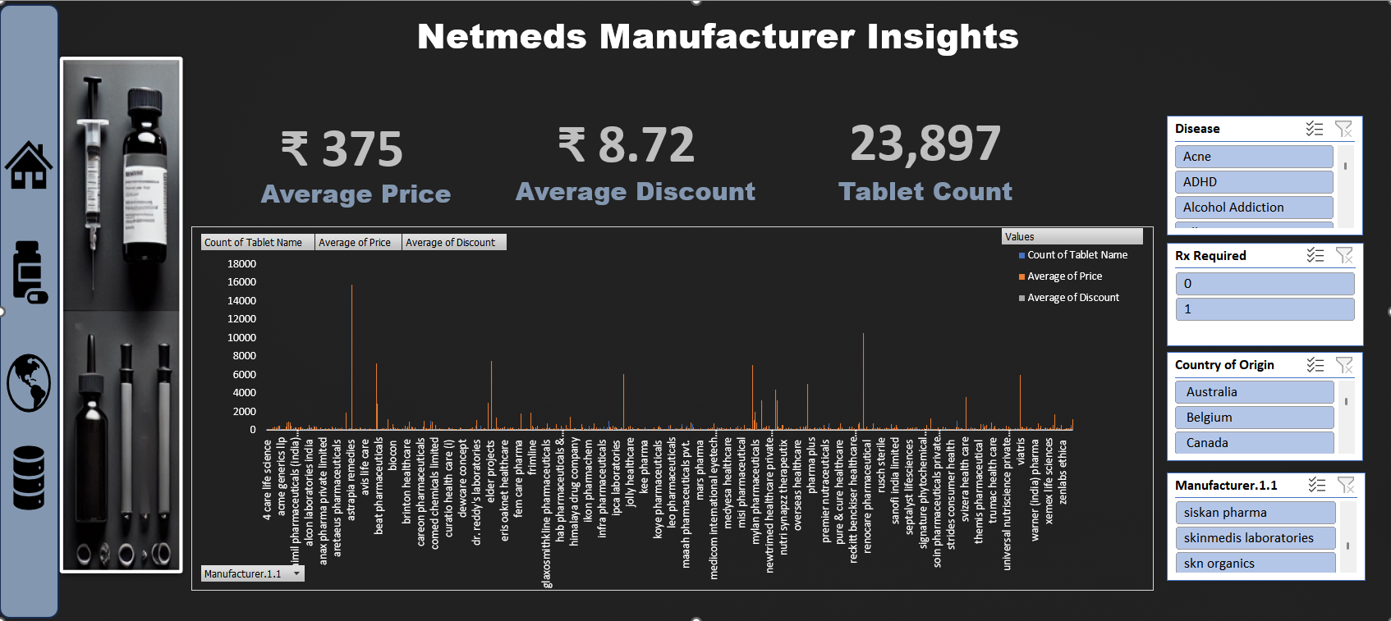

Slide 5
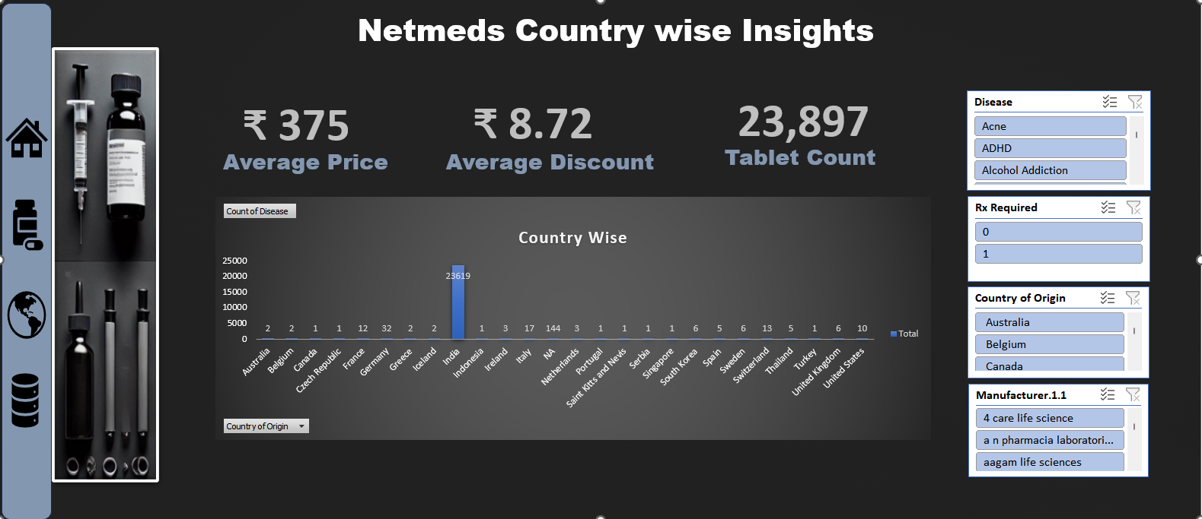

Slide 6
Netmeds Revenue Model
Commission-Based Revenue (Primary Source)
How It Works:
Netmeds earns commissions on the sale of prescription medicines, OTC (over-the-counter) drugs, and FMCG products listed on its platform.
Pharmaceutical companies, distributors, and third-party sellers pay Netmeds a percentage of their sales revenue for selling through the platform.
Revenue Contribution:
In FY18, Netmeds earned ₹4.46 crore from commissions.
The company mainly caters to the chronic segment (patients requiring regular medications), a market worth $10 billion annually in India.
Marketing & Advertising Revenue
How It Works:
Netmeds earns revenue by offering promotional space and advertising services to pharmaceutical companies and healthcare brands.
This includes: ✔ Featured product placements ✔ Banner ads on the website/app ✔ Email and push notification promotions
Revenue Contribution:
Brands pay marketing fees to boost their product visibility and sales on Netmeds' platform.

Slide 7
Shipping & Convenience Charges
How It Works:
Netmeds charges customers for delivery services, depending on order size, urgency, and location.
Standard delivery is free for orders above a certain amount, while express or same-day delivery comes with additional charges.
B2B Wholesale Business
How It Works:
Netmeds is evaluating a B2B model, supplying medicines to local pharmacies at wholesale rates.
This model will allow the company to sell in bulk to retailers and medical stores, increasing its revenue potential.
Franchise Model (Expansion Revenue Stream)
How It Works:
Netmeds is expanding its physical presence by offering franchise opportunities.
Franchise owners pay an initial investment (~₹20 lakh) and share revenue/profit with Netmeds.

Slide 8
Analysis of Netmeds' Prescription-Driven Market and Potential Gaps in Medication Availability
Prescription-Based Market: Around 88.98% of drugs on Netmeds require a doctor's prescription, highlighting the dominance of prescription-driven sales.
Stroke and Tuberculosis (TB) Medications:
In India, approximately 49 out of 1,000 people die due to stroke, and 29 out of 1,000 from TB.
While acute cases might not prefer online purchases, post-stroke patients (especially those with hemiplegia or paresis) and TB patients (who require prolonged medication) could benefit from online accessibility.
Netmeds should consider adding these essential medications to their stock.
Ischemic Heart Disease & Chronic Conditions:
121 out of 1,000 deaths in India are due to ischemic heart disease.
Patients with stents, bypass surgery, or CABG need lifelong medication.
While Netmeds has a strong inventory for diabetes, high cholesterol, and hypertension, expanding offerings for cardiac care medications can enhance availability and meet patient needs.

Slide 9
Estimating Netmeds Revenue
Notified TB patients: 26 lakh TB patients in 2023 (increase from 24.22 lakh cases in 2022). Reporting of cases: ~67% reporting being done by the public sector and ~33%) from private sector.
Step 1: Estimating 2025 Revenue
Baseline 2024 Revenue
Netmeds' 2024 revenue was ₹67.24 crore (a drop from 2023).
Adding Revenue from TB Medications
We estimated a potential market size of 39,000 TB patients.
If each patient spends ₹3,000 per year on TB medications, that adds: 39,000×3,000=₹117crore
If each patient spends ₹4,000 per year, that adds: 39,000×4,000=₹156crore
Assuming Netmeds’ existing revenue also grows slightly (~10-15%) 67.24×1.15=₹77crore
Final Revenue Estimate (Existing + TB Market) = ₹150 - ₹170 crore

Slide 10
Step 2: Estimating Expenses
Netmeds' 2024 expenses were ₹60.83 crore. With expansion into TB meds, costs will rise due to:
Stocking & Procurement of TB medicines
Marketing & Awareness
Logistics & Distribution
Let’s assume a 50-70% increase in expenses:
60.83×1.8=₹110crore
60.83×2.1=₹130
Thus, estimated expenses for 2025 = ₹110 - ₹130 crore
Step 3: Estimating Profit
Profit is calculated as:
Profit=Revenue−Expenses
(₹150 Cr revenue - ₹130 Cr expenses) = ₹20 Cr profit
Upper bound (₹170 Cr revenue - ₹110 Cr expenses) = ₹35 Cr profit
Thus, the realistic profit estimate is ₹20 - ₹35 crore.
Profit Increase=151%

Slide 11
Recommendation for Netmeds: Enhancing Accessibility & Visibility of Post-Stroke Medications
To better serve patients recovering from stroke, Netmeds can implement the following strategies to increase trust, improve visibility, and drive sales for essential post-stroke medications.
1️⃣ Create a Dedicated "Post-Stroke Care" Section
Introduce a separate category for Post-Stroke Medications, similar to existing sections for Diabetes, Hypertension, and Cardiac Care.
Include: Blood thinners & anticoagulants (e.g., Aspirin, Clopidogrel, Warfarin) to prevent further strokes. Cholesterol-lowering drugs (e.g., Statins like Atorvastatin, Rosuvastatin) to reduce heart disease risk. Blood pressure medications (e.g., ACE inhibitors, Beta-blockers) to prevent hypertension-related strokes. Neuroprotective drugs & nerve regeneration supplements (e.g., Citicoline, Piracetam) to support brain recovery. Physical rehabilitation aids (e.g., muscle relaxants, physiotherapy supplements).
2️⃣ Cross-Reference Post-Stroke Medications in Related Categories
Since stroke-related medicines fall under different categories, Netmeds can cross-list them in: Cardiac Care – Blood thinners & cholesterol-lowering drugs. Hypertension Management – BP medications preventing stroke recurrence. Neurology & Brain Health – Cognitive enhancers & nerve recovery drugs. Pain & Muscle Relaxants – Medications for post-stroke spasticity and movement recovery.
Add a small note/link under relevant medications: ➝ "This medication is commonly prescribed for stroke recovery. Explore our full Post-Stroke Care range → [link]."

Slide 12
3️⃣ Build Trust & Awareness Among Stroke Patients & Caregivers
Include an educational section on the "Post-Stroke Care" page, addressing: Why long-term medication adherence is crucial. Commonly prescribed medications and their benefits. Lifestyle modifications for stroke survivors.
Partner with neurologists or stroke specialists to provide credibility & recommendations.
Expected Impact
Improved customer confidence – Stroke survivors & caregivers will see Netmeds as a trusted platform for long-term stroke recovery. Higher conversions – Dedicated categorization & visibility make it easier for customers to find & buy essential medications. Stronger market positioning – Netmeds can differentiate itself by addressing critical healthcare needs beyond general medications.

